Slide 1
Creating Custom Workflow Activities with Windows Workflow Foundation
Keith Elder
Team Leader, Sr. Software Engineer
Quicken Loans

Slide 2
About Quicken Loans
Originally founded in 1985 as Rock Financial by Dan Gilbert
Grew to one of the largest independent mortgage banks in the country
1998 IPO
1999 Launched Rockloans.Com
1999 Intuit, Inc (makers of TurboTax and Quicken) purchased Rock Financial.
July 2002 Dan Gilbert purchased Quicken Loans back from Intuit. Retained Quicken Loans branding and marketing initiatives.
4500 employees
Largest online retail home loan lender

Slide 3
What do you need to leverage Windows Workflow Foundation?
.Net 3.0 Framework
Visual Studio 2005
Visual Studio Workflow Extension
*Business Logic
* If you go to the store. Buy me a snickers bar. Else buy me a bag of chips.

Slide 4
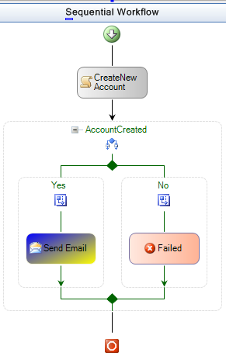
Why Custom Activities?
They’re cool!
Impress your friends
Reusable Logic
Easy for end users to configure
Easy for developers
Easier to follow logic flow

Slide 5
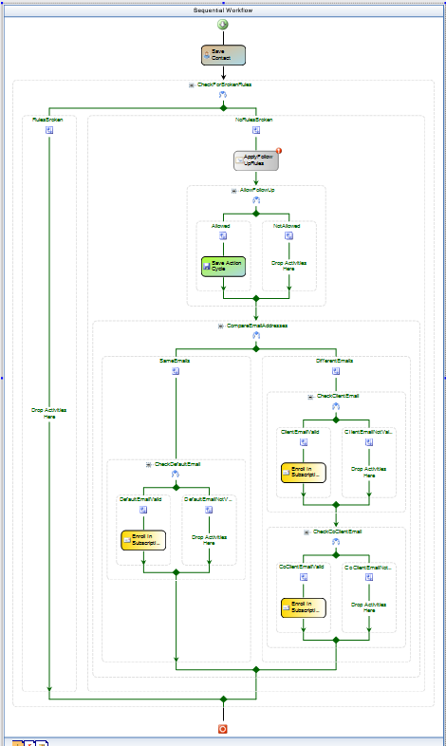
Real-life workflow with three custom activities.
Would you rather look at, and edit this workflow?
Or would you rather stare at 4000 lines of C# code?
Let’s Build ONE!

Slide 6
Resources
My Blog
http://keithelder.net/blog/
Email
keith@keithelder.net
Resources
http://msdn.microsoft.com/workflow/
http://wf.netfx3.com

